Slide 1


Slide 2

Contents
Introduction
Geographical locations and stats
Reviews and Heat Mapped Ratings
Visitor Experience and Revenue
Demonstration

Slide 3

Introduction
Audience
United States Travel and Tourism Administration
Purpose
Market Museums as Travel Hotspots (for National & International Tourists)
Dashboard
High-level View of Locations
Top State and Major City Counts
Heatmap of Rated Museums to Major cities
Top-Rated and Reviewed Museums
View of Income/Revenue in prox. to Major Cities

Slide 4
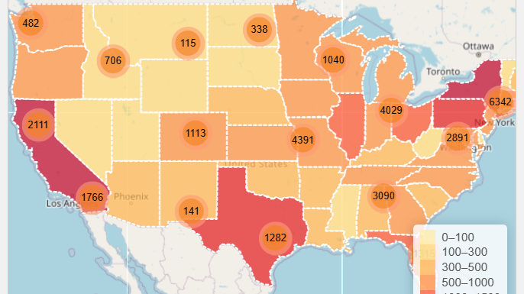
Geographical locations

Slide 5

Stats
Approx. 33,000 Museums in the United States
Top 10 Stats:
Top States with museums
Over 2,500 Museums in California:
Approx. 950 Museums in Virginia
Top Major Cities with museums
Close to 300 Museums in New York
Around 70 Museums in Miami

Slide 6
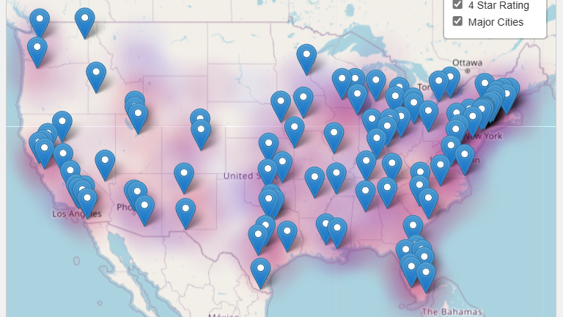
Heat Mapping of Ratings

Slide 7

Reviews
Review Count (Top 10)
Provides an overview of attendance
Impactful exhibits that museums were reviewed
The National 9/11 Memorial Museum - > 45k
The Getty Center - < 10k reviews
Ratings
View provides an outlook of Museum Averages

Slide 8
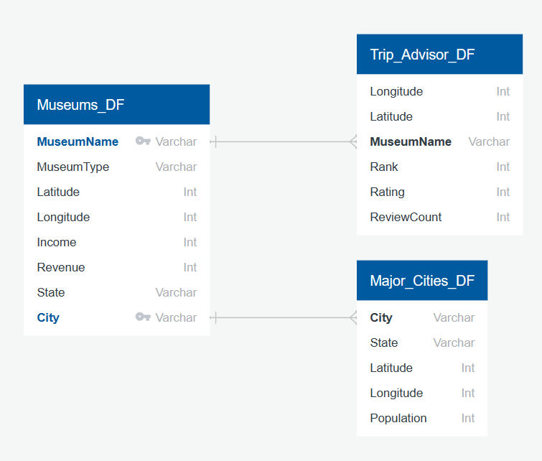
Database Schema

Slide 9
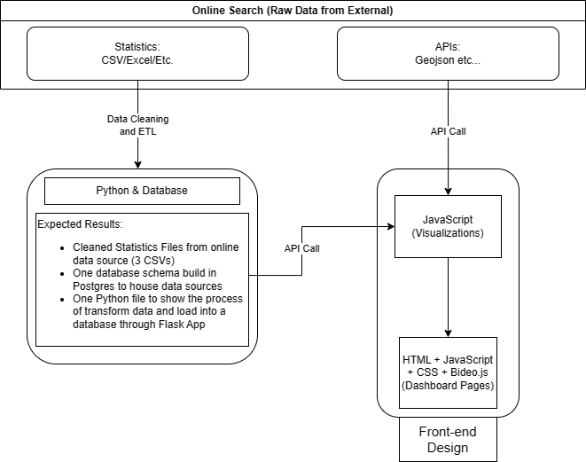
Architecture

Slide 10
Demonstration

Slide 11

Questions?

Slide 12

Thank You

Slide 13
Appendix

Slide 14
Financial Location of Museums

Slide 15

Revenue
Largest Revenue Generation
Research based
Smallest Revenue Generation
Exhibitions only
Length of stay
By length of Stay
By type of exhibition, etc

